Slide 1
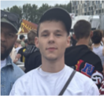
Rens van den Berg
224190
Learning Log
2023/2024
Block B

Slide 2

How To Use
This Template
As a student at Breda University of Applied Sciences studying to become a professional, you are required to provide evidence that demonstrates your professional learning and growth during the block. This template is intended to provide you with a well-structured and organised format for doing this effectively. Keep in mind that certain competencies may require you to update your evidence every week, and others may have only be relevant during a particular week or two.
With the evidence you present here teachers should get a clear and comprehensive overview of your progress, how you’ve engaged with feedback, as well as your general attitude and performance as a student and as an aspiring professional developer.
Note that number and size of text boxes and how they are organized on each slide may be modified as needed. It is up to you to decide what layout is most effective for the content you are providing. You may also add slides if needed, but try to be as economical as possible, i.e. quality over quantity. Focus on the things that are the most significant and meaningful.
You are also free to stylise this template to improve the graphic design and visual appeal, but please remember its purpose: to provide evidence of your progress towards becoming a professional developer. Changes should only enhance and extend the information, and may never subtract. I.e. do not delete anything or change the order of things. If in doubt, seek approval from your teachers!

Slide 3
Learning Log
Structure
Section A - My Plan
Must be completed in week 1
Your plan describes your goals for the block. Starting with where you are right now, where do you want to be at the end of the block? I.e. what role(s) will you take responsibility for, and how will you demonstrate progress relevant to the ILOs for this block? What tasks and deliverables are best aligned with your role and the project brief?
Section B - Weekly Log Must be updated every week
This is simply a log (journal) of what you do each day, and what you learn from it. It is your responsibility to update this regularly and frequently. Be sure to include working links to any specific evidence you are referencing (and make sure that you share your docs with the teaching team). Note: some of the required information may be captured in production documents such as your work log or peer reviews.
In such cases, you simply need to provide links to those artifacts and may include any explanatory comment or reflection you feel is appropriate.
(Some reflection is almost always a good idea as it provides the foundation for Section D.)
Section C - ILO’s Must be completed in week 8, but should be updated regularly.
This is where you link your evidence to each of the Intended Learning Outcomes of this block.
Section D – Reflection Must be completed in week 8
Summative reflection on your progress during the block including a critical assessment of everything you did and learned during the block. This is a comprehensive review of everything recorded in Section B, evaluated against the goals and planning laid out in Section A.
Section A
Starting this block
Goals
Section B
Week log section
Section C
ILO section
Section D
Block reflection

Slide 4
Section A
The student sets ambitious, S.M.A.R.T./ C.L.E.A.R goals in alignment with the project brief, their chosen role(s), content of the assessment rubric and their personal long-term goals
A
Goal Setting
Notes:
MUST BE UPDATED EVERY WEEK
This is simply a log (journal) of what you do each day, and what you learn from it. It is your responsibility to update this regularly and frequently. Be sure to include working links to any specific evidence you are referencing (and make sure that you share your docs with the teaching team). Note: some of the required information may be captured in production documents such as your work log or peer reviews.
In such cases, you simply need to provide links to those artifacts and may include any explanatory comment or reflection you feel is appropriate.
(Some reflection is almost always a good idea as it provides the foundation for Section C.)

Slide 5
A
Where am I starting?
1/2
Feedback from previous assessment - Previous block’s grade
1.6
You can make a much better block.
Notes:
Copy and paste the feedback from the previous block’s assessment into the text box.
Copy and paste the bullet points you listed on the “Lessons Learned” page in section C of your last block’s log.
Compare the grade you gave yourself with the grade you received, and reevaluate or restate your feeling on your current level of progress.

Slide 6
A
What are my goals?
1/1
S | Specific: Be specific when determining your goal. The more specific the better. Putting a real figure to your goal helps make it measurable. When specific and measurable your subconscious mind cannot override your goals, they become achievable.
M | Meaningful: This is the WHY of your goal setting. When your specific goal has enough meaning for you, you will do whatever it takes to achieve it. When your goal is meaningful the more profound and life altering the results are.
A | Achievable: Choosing realistic and short-term goals helps them be more achievable. Long-term goals can be larger and take more time to achieve. Planning smaller short-term goals as steps to larger long-term goals assists in achieving them.
R | Relevant: Each goal you set must be in line with your core values and in harmony with what YOU want out of life. Contradictions in values and goals leads to frustration and loss of motivation. Designing your goals with the expectation of your personal success.
T | Time-Bound: Setting a time limit on achieving a goal makes it measurable. When a goal is measurable you can SEE your progress and support your motivation and commitment. Giving your goal a time limit assists you in holding yourself accountable to its completion.
E | Evaluate: By evaluating your goals on a regular basis you will be much more likely to achieve them. It is easy to forget about long-term goals if they are not revisited from time to time. This also helps you assess if the goal you are working on remains in line with your core values and helps you measure your progress.
R | Readjust: Readjustments occur when goals are determined, through re-evaluation, to be misaligned with your values or long-term goals. This is especially helpful when you have been unable to achieve a goal in the time limits you set. This gives you the opportunity to modify your approach and increase your chances of success.
Personal and professional development goals
Personal:
Each morning before starting work, I will spend 10 minutes drafting a to-do list for the day, categorizing tasks by priority (high, medium, low) to enhance my daily productivity. I will review this list at the end of each workday to assess completion and adjust planning for the next day, aiming for a 90% task completion rate each week.
Specific: The goal clearly outlines the task of creating a daily to-do list each morning, including the time allocation (10 minutes) and the method (categorizing tasks by priority). It specifies the review process at the end of the day and sets a clear target for task completion.
Meaningful: Crafting a prioritized to-do list contributes significantly to daily productivity by ensuring that critical tasks are focused on and completed. This structured approach to task management can lead to improved efficiency and effectiveness in both personal and professional areas.
Achievable: Setting aside 10 minutes at the start of the day and a review session at the end is a realistic commitment. Aiming for a 90% task completion rate each week allows for flexibility and acknowledges that not every task may be completed due to unforeseen circumstances, making the goal attainable.
Relevant: This goal is directly related to enhancing daily productivity, which is a common objective for many individuals seeking to optimize their time and output. It addresses a practical need for structure and organization in day-to-day tasks.
Time-bound: The goal includes specific times for when the to-do list should be created (each morning before work) and reviewed (at the end of each workday). It also sets a weekly benchmark (90% task completion rate) to measure progress.
Evaluate: The daily review of the to-do list serves as an evaluation mechanism to assess which tasks were completed and to what extent the day's objectives were achieved. The weekly aim of a 90% completion rate provides a metric for evaluating overall weekly productivity.
Readjust: The process of reviewing the list at the end of the day and adjusting planning for the next day allows for continual readjustment of goals and tasks. This flexibility ensures that priorities can be reshuffled as needed, and new tasks can be integrated seamlessly into the planning process.
Notes:
Describe your goals for this block using the SMARTER method. Make sure they are clear, relevant, have a measurable outcome, and can be recorded. Consider how well do they align with the role(s) you wish to take, and with the requirements given in the project brief. Think about the objectives you plan to choose, or that are mandated by the project. Are there any competencies that you need to focus on?
For each goal, find concrete examples of tasks you expect to undertake that will demonstrate this within the project for the block. Make sure the plan has an outcome that can be tracked and assessed. Make sure you have a clearly stated target for each goal. If you are unsure of how to demonstrate something, ask for help from your teachers.

Slide 7
A
What are my goals?
1/1
S | Specific: Be specific when determining your goal. The more specific the better. Putting a real figure to your goal helps make it measurable. When specific and measurable your subconscious mind cannot override your goals, they become achievable.
M | Meaningful: This is the WHY of your goal setting. When your specific goal has enough meaning for you, you will do whatever it takes to achieve it. When your goal is meaningful the more profound and life altering the results are.
A | Achievable: Choosing realistic and short-term goals helps them be more achievable. Long-term goals can be larger and take more time to achieve. Planning smaller short-term goals as steps to larger long-term goals assists in achieving them.
R | Relevant: Each goal you set must be in line with your core values and in harmony with what YOU want out of life. Contradictions in values and goals leads to frustration and loss of motivation. Designing your goals with the expectation of your personal success.
T | Time-Bound: Setting a time limit on achieving a goal makes it measurable. When a goal is measurable you can SEE your progress and support your motivation and commitment. Giving your goal a time limit assists you in holding yourself accountable to its completion.
E | Evaluate: By evaluating your goals on a regular basis you will be much more likely to achieve them. It is easy to forget about long-term goals if they are not revisited from time to time. This also helps you assess if the goal you are working on remains in line with your core values and helps you measure your progress.
R | Readjust: Readjustments occur when goals are determined, through re-evaluation, to be misaligned with your values or long-term goals. This is especially helpful when you have been unable to achieve a goal in the time limits you set. This gives you the opportunity to modify your approach and increase your chances of success.
Personal and professional development goals
Professional:
Each week, I will complete one chapter of the "Advanced Computer Vision with Python" course available on ComputerVision.zone. To ensure structured progress, I will allocate two hours every Saturday morning for focused study and practice exercises within the chapter. Every week, I will evaluate in the learning log.
Specific: It clearly defines the task (completing one chapter weekly), the resource (the course on ComputerVision.zone), and the study time (two hours every Saturday morning).
Measurable: Progress can be measured by the completion of chapters and monthly review exercises or projects.
Achievable: Allocating a manageable amount of time weekly makes it feasible to stay consistent with the coursework.
Relevant: This goal is directly linked to acquiring advanced knowledge in computer vision, presumably aligning with professional or personal interests in this field.
Time-bound: The goal has a weekly timeframe for chapter completion and a weekly evaluation point.
Evaluate: I will evaluate weekly in the learning log.
Readjust: Based on weekly evaluations, adjustments can be made to the study schedule or methods to improve learning outcomes.
Notes:
Describe your goals for this block using the SMARTER method. Make sure they are clear, relevant, have a measurable outcome, and can be recorded. Consider how well do they align with the role(s) you wish to take, and with the requirements given in the project brief. Think about the objectives you plan to choose, or that are mandated by the project. Are there any competencies that you need to focus on?
For each goal, find concrete examples of tasks you expect to undertake that will demonstrate this within the project for the block. Make sure the plan has an outcome that can be tracked and assessed. Make sure you have a clearly stated target for each goal. If you are unsure of how to demonstrate something, ask for help from your teachers.

Slide 8
Section B
B
Progress Log
Notes:
MUST BE UPDATED EVERY WEEK
This is simply a log (journal) of what you do each day, and what you learn from it. It is your responsibility to update this regularly and frequently. Be sure to include working links to any specific evidence you are referencing (and make sure that you share your docs with the teaching team). Note: some of the required information may be captured in production documents such as your work log or peer reviews.
In such cases, you simply need to provide links to those artifacts and may include any explanatory comment or reflection you feel is appropriate.
(Some reflection is almost always a good idea as it provides the foundation for Section C.)

Slide 9
1
Week 1 - Log
1/2
What did you do?
Reflection
What goal(s) did you set for this week?
Make a good start, finish first 2 datalab tasks.
What have you actually been able to do?
I finished first 2 datalab tasks.
Showcase the evidence of your progress (production artifacts, short descriptions-links-pictures animated gifs, etc.)
Below are two pictures showing root and shoot masks of one of the two pictures I labeled for task 1.
This link leads to a Jupyter notebook which contains my solution to task 2.
How did the week go?
Week 1 was a very productive week. I finished everything I wanted to and filled in my work and learning log on time.
What went well?
I had very productive datalab sessions, especially on Wednesday.
What didn’t go so well?
This week everything went exact as planned, if not better.
What did you learn?
I learned how to label images in LabKit.
I learned how to use canny edge detection in Python.
I learned how to solve task 2.
What could be added as an Action point looking forward to next week?
Keep the same motivation as week 1

Slide 10
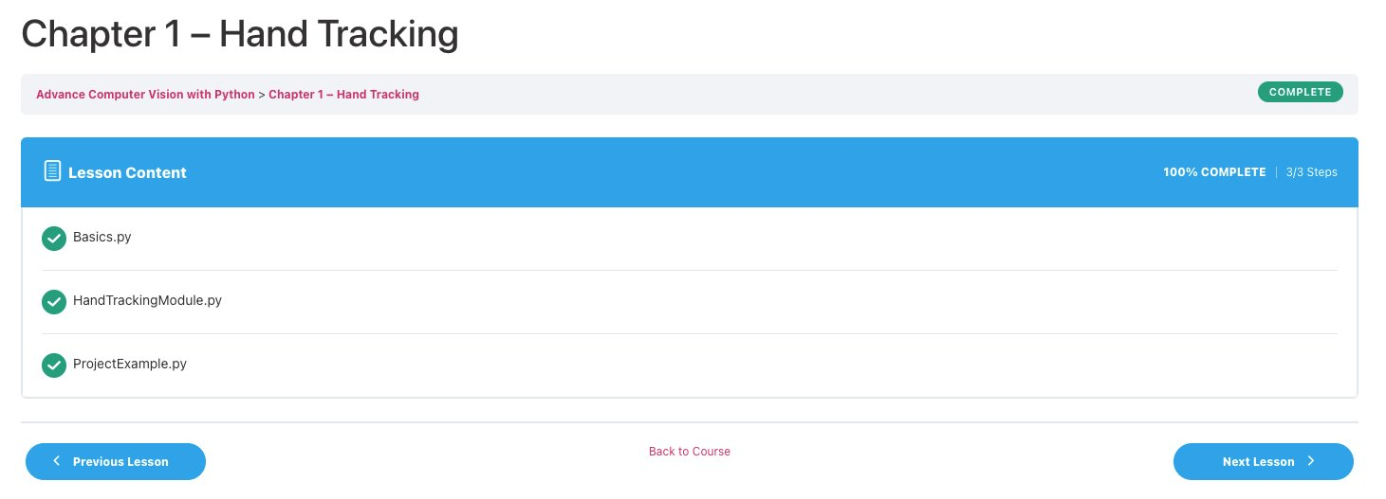
1
Week 1 - SMARTER
1/2
Evaluation personal SMARTER goal
Evaluation professional SMARTER goal
Established a strong foundation in daily planning and task prioritization.
Demonstrated commitment to personal well-being through hydration and gratitude practice.
Successfully balanced educational tasks with personal responsibilities.
Successfully completed Chapter 1 on Hand Tracking, practicing with basics and advanced tracking techniques using MediaPipe in Python. Faced challenges with optimizing tracking performance, leading to a plan for further exploration of MediaPipe documentation and testing under varied conditions next week.
Time tracking
Planned: 4H
Actual: 4H

Slide 11
1
Week 1 - Feedback
2/2
Team, individual, peer, workshop feedback
Alican Feedback: You can use the format of the notebook for task 2 that you showed it, it looks good.
Response to Feedback
Thank you Alican. I'm going to use that format.
Michal Feedback: You look beautiful
Response to Feedback
Thanks.

Slide 12
2
Week 2 - Log
1/2
What did you do?
Reflection
What goal(s) did you set for this week?
Complete task 3 and 4.
What have you actually been able to do?
I have completed task 1 and 2.
Showcase the evidence of your progress (production artifacts, short descriptions-links-pictures animated gifs, etc.)
Link to task 2
How did the week go?
It was a good week, I'm happy that I completed task 2.
What went well?
I completed task 2.
What didn’t go so well?
I really tried to finish task 3, but I couldn't yet.
What did you learn?
All skills gained to solve task 2.
What could be added as an Action point looking forward to next week?
Finish task 3 and 4!
Reflection on deviation:
Friday, I spent 1 hour less on task 4 than planned. This was because I finished my goals for the day earlier than expected.

Slide 13
2
Week 2 - Feedback
2/2
Team, individual, peer, workshop feedback
[Michal] Feedback: You are making great progress. Keep on working.
Response: Thank you.

Slide 14
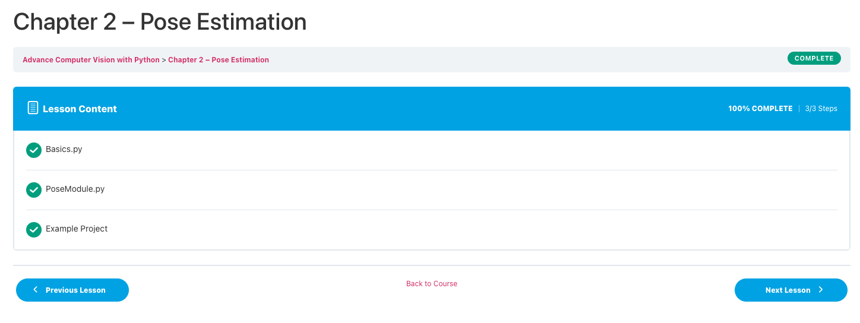
2
Week 2 - SMARTER
1/2
Evaluation personal SMARTER goal
Evaluation professional SMARTER goal
Maintained consistency in room cleanliness and personal health routines.
Showed improvement in managing and completing educational tasks.
Actively engaged in physical well-being through regular gym visits.
Completed Chapter 2 on Pose Estimation, exploring basics and applying techniques in various examples. Progressed in understanding pose landmarks and developing pose detection modules, though faced challenges in accurately capturing complex poses.
Time tracking
Planned: 4H
Actual: 4H

Slide 15
3
Week 3 - Log
1/2
What did you do?
Reflection
What goal(s) did you set for this week?
Complete task 3 and 4
Complete all self study work
What have you actually been able to do?
Task 1 and 2
Self study work
Showcase the evidence of your progress (production artifacts, short descriptions-links-pictures animated gifs, etc.)
How did the week go?
The week went good. DataLab sessions were good.
What went well?
I did a lot of work on the project. Finished task 3.
What didn’t go so well?
I still did not finish task 4.
What did you learn?
I learned how to complete task 3.
What could be added as an Action point looking forward to next week?
Finish task 4 and keep working.

Slide 16
3
Week 3 - Feedback
2/2
Team, individual, peer, workshop feedback
[Stijn] Feedback: Well done, it was a good week.
Response: Thank you.

Slide 17
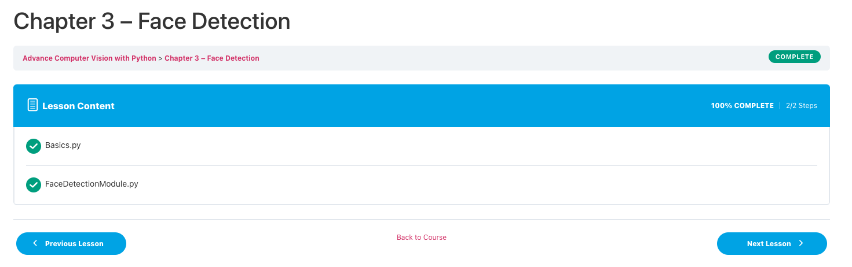
3
Week 3 - SMARTER
1/2
Evaluation personal SMARTER goal
Evaluation professional SMARTER goal
Continued to excel in educational pursuits and personal health management.
Demonstrated adaptability in daily planning, effectively incorporating new tasks.
Implemented the habit of gratitude, contributing to a positive mindset.
Completed chapter 3 on Face Detection, mastering the basics and creating a custom Face Detection Module. Successfully implemented face detection algorithms using MediaPipe, enhancing ability to identify and annotate faces in video streams with precision.
Time tracking
Planned: 4H
Actual: 5H
Reflection: It took me one hour longer because it was a bit harder than expected, and I had to watch an extra video on MediaPipe to understand how to implement the correct functions.
Action points: Next time, plan ahead.

Slide 18
4
Week 4 - Log
1/2
What did you do?
Reflection
What goal(s) did you set for this week?
Finish task 4 and 5.
What have you actually been able to do?
I finished task 3 last week and now I'm patching the pictures for task 4.
Showcase the evidence of your progress (production artifacts, short descriptions-links-pictures animated gifs, etc.)
Task 4
How did the week go?
It was an ok week.
What went well?
I made progress on task 4.
What didn’t go so well?
I wanted to make more progress on task 4, but it's harder than expected which is frustrating me.
What did you learn?
I learned how to patch images to load them into a model. I learned about U net and semantic segmentation deep learning models.
What could be added as an Action point looking forward to next week?
Finish task 4 and ask questions if I don't understand.
Reflection on deviation:
Thursday, I spent 2 hours less on a self study task than planned. This was because I finished earlier. It was not as much work as expected.

Slide 19
4
Week 4 - Feedback
2/2
Team, individual, peer, workshop feedback
[Max] Feedback: You made good progress this week.
Response: Thanks Max.

Slide 20
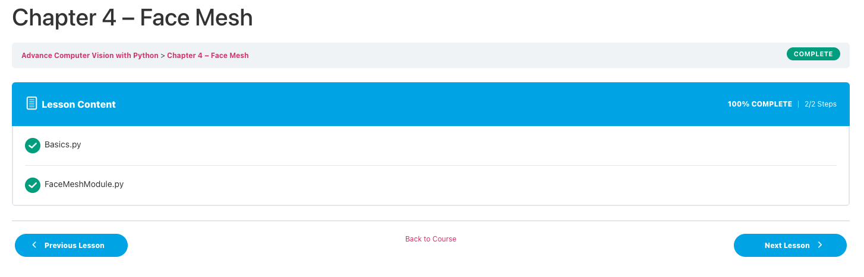
4
Week 4 - SMARTER
1/2
Evaluation personal SMARTER goal
Evaluation professional SMARTER goal
Effectively managed a busy schedule, balancing educational tasks with personal goals.
Showed resilience in maintaining health and wellness routines amidst academic pressures.
Exhibited growth in planning and organization skills, effectively setting and achieving weekly goals.
Completed chapter 4 on Face Mesh, effectively learning to apply and customize face mesh techniques with MediaPipe for detailed facial landmark detection. I have expanded my skills in handling more complex facial recognition tasks, demonstrating the ability to map intricate facial features in real-time video feeds.

Slide 21
5
Week 5 - Log
1/2
What did you do?
Reflection
What goal(s) did you set for this week?
Finish task 4 and 5, start on robotics tasks.
What have you actually been able to do?
Made progress on task 4, patched images, made model.
Showcase the evidence of your progress (production artifacts, short descriptions-links-pictures animated gifs, etc.)
Task 4
How did the week go?
It was a good week.
What went well?
I almost finished task 4.
What didn’t go so well?
Everything went good this week, but I really wanted to finish task 4 this week.
What did you learn?
Semantic segmentation on plant images.
What could be added as an Action point looking forward to next week?
Finish task 4 and keep making the progress.
Reflection on deviation:
Wednesday, I spent 3 hours less on a self study task than planned. This was because I finished earlier. It was not as much work as expected.

Slide 22
5
Week 5 - Feedback
2/2
Team, individual, peer, workshop feedback
[Lea] Feedback: I can see that you are doing great this block.
Response: Thanks.

Slide 23
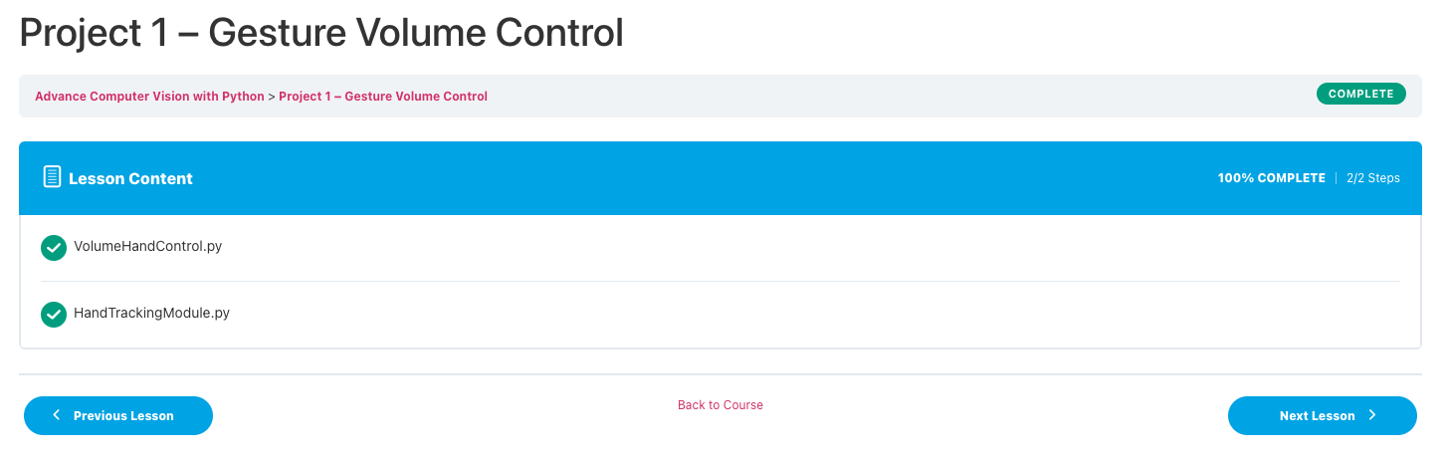
5
Week 5 - SMARTER
1/2
Evaluation personal SMARTER goal
Evaluation professional SMARTER goal
Demonstrated significant progress in educational projects and personal development.
Maintained a strong focus on health through regular exercise and hydration.
Cultivated a positive outlook through consistent practice of gratitude.
Completed Project 1 on Gesture Volume Control, effectively integrating hand tracking techniques to manipulate volume settings through gesture recognition. Demonstrated practical application of previous chapters' learnings by creating a functional tool using Python, OpenCV, and the pycaw library for audio control. This project showcased the ability to combine computer vision with real-world interactivity.
Time tracking
Planned: 5H
Actual: 5H

Slide 24
6
Week 6 - Log
1/2
What did you do?
Reflection
How did the week go?
Very good.
What went well?
I finished task 4, 5 and 6.
What didn’t go so well?
Everything went good.
What did you learn?
Semantic segmentation
Instance segmentation
Landmark detection
What could be added as an Action point looking forward to next week?
Keep on with the same workflow.
Reflection on deviation:
Wednesday, I spent 1 hour less on a self study task than planned. This was because I finished earlier. It was not as much work as expected.
On Friday, I spent 2 hours less on task 6 than planned, because I finished the task earlier than expected.
What goal(s) did you set for this week?
Finish task 4, 5 and 6.
What have you actually been able to do?
Made good progress.
Showcase the evidence of your progress (production artifacts, short descriptions-links-pictures animated gifs, etc.)
Task 4
Task 5
Task 6

Slide 25
6
Week 6 - Feedback
2/2
Team, individual, peer, workshop feedback
[Michal] Feedback: Well done on completing all the tasks.
Response: Thank you.

Slide 26
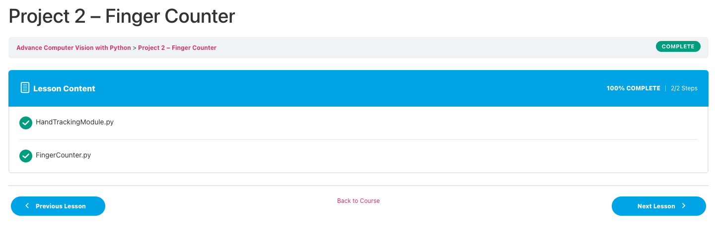
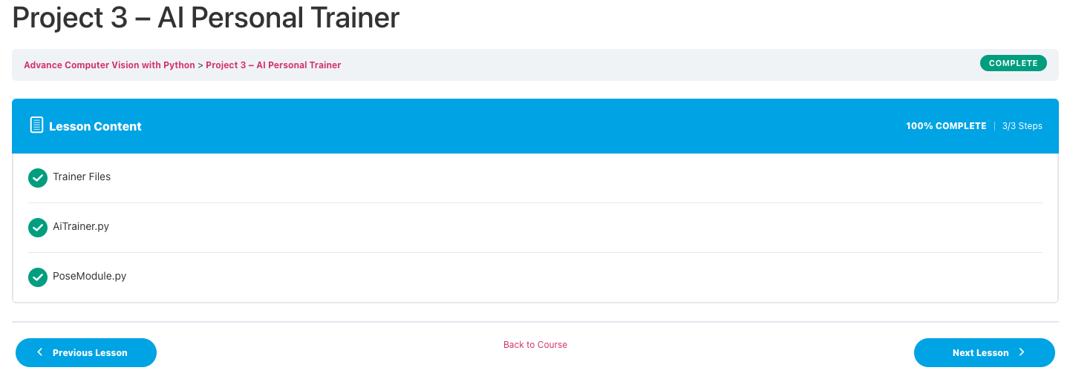
6
Week 6 - SMARTER
1/2
Evaluation personal SMARTER goal
Evaluation professional SMARTER goal
Excellently balanced university work with personal development activities.
Showed commitment to physical health and well-being through consistent gym visits and hydration.
Continued to foster a positive mindset through gratitude and appreciation for surroundings.
Completed Project 2 on Finger Counting, effectively utilizing the HandTrackingModule to recognize and count fingers. This project demonstrated the ability to apply hand landmark detection for interactive applications. Additionally, initiated Project 3 on an AI Personal Trainer, incorporating PoseModule to analyze exercises and count repetitions, showcasing the application of pose estimation in fitness and health.
Time tracking
Planned: 10H
Actual: 8H
Reflection: I finished quicker than expected.
Action points: Next time, when finished earlier, work on other projects.

Slide 27
7
Week 7 - Log
1/2
What did you do?
Reflection
What goal(s) did you set for this week?
Finish and evidence all tasks until task 8.
What have you actually been able to do?
All tasks until task 7.
Showcase the evidence of your progress (production artifacts, short descriptions-links-pictures animated gifs, etc.)
Task 7
Task 8
How did the week go?
Very good, I finished everything I wanted.
What went well?
I finished all CV tasks.
What didn’t go so well?
Everything went pretty good, but I accidentally submitted an altered submission to Kaggle, I fixed it with Alican tho.
What did you learn?
How to combine task 1 tm 7 to finish task 8.
What could be added as an Action point looking forward to next week?
End strong.
Reflection on deviation:
Wednesday, I spent 2 hours less on task 7 than planned. This was because I finished my goals earlier than expected.

Slide 28
7
Week 7 - Feedback
2/2
Team, individual, peer, workshop feedback
[Alican] Feedback: Put ILO's into section C.
Response: Ok will do.

Slide 29
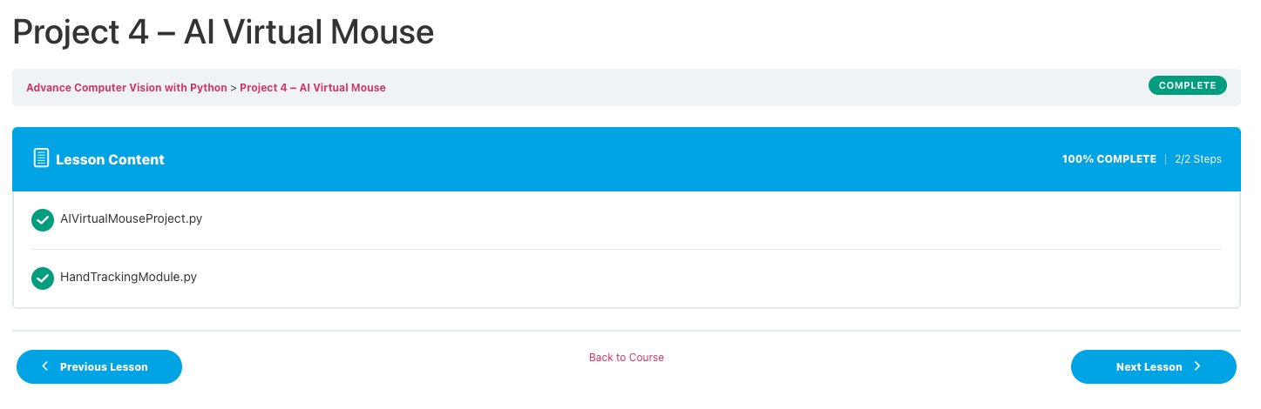
7
Week 7 - SMARTER
1/2
Evaluation personal SMARTER goal
Evaluation professional SMARTER goal
Achieved a high level of productivity in educational tasks, demonstrating effective time management.
Maintained commitment to personal health and well-being routines.
Exhibited a positive attitude, finding gratitude in daily life and relationships.
Successfully developed Project 4 on AI Virtual Mouse, integrating hand detection to control mouse movements and clicks through gestures. This project illustrated the ability to translate hand movements into precise screen coordinates, achieving a seamless interface between user gestures and computer control. This application of computer vision technology showcases potential for innovative human-computer interaction solutions.
Time tracking
Planned: 4H
Actual: 4H

Slide 30
8
Week 8 - Log
1/2
What did you do?
Reflection
What goal(s) did you set for this week?
What have you actually been able to do?
Finished untill task 11.
Showcase the evidence of your progress (production artifacts, short descriptions-links-pictures animated gifs, etc.)
How did the week go?
What went well?
What didn’t go so well?
What did you learn?
What could be added as an Action point looking forward to next week?
Reach at least good criteria for ILO 1.1 and 2.2 (2.5)
Reach at least good criteria for ILO 4.1 and 4.2 (2.5)
Finish report and reach excellent criteria for ILO 5.1 (3)

Slide 31
8
Week 8 - Feedback
2/2
Team, individual, peer, workshop feedback
[Reviewer] Feedback
Response

Slide 32
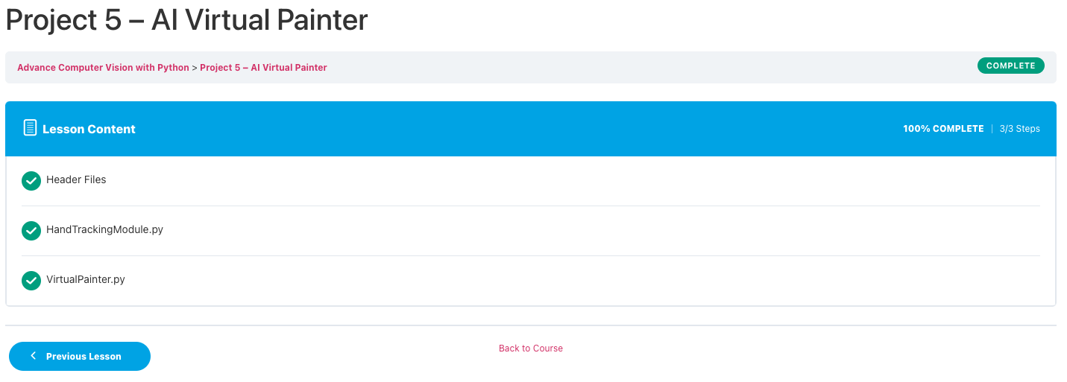
8
Week 8 - SMARTER
1/2
Evaluation personal SMARTER goal
Evaluation professional SMARTER goal
Successfully completed all set goals, showing remarkable progress in both personal and educational aspects.
Maintained consistency in health and wellness practices, contributing to overall well-being.
Continued to cultivate a positive and grateful mindset, appreciating personal relationships and achievements.
Overall Reflection:
Over the eight weeks, there has been a notable improvement in task management, personal health, and productivity. The consistent practice of setting daily goals, maintaining health routines, and expressing gratitude has contributed to a balanced and positive lifestyle. The discipline in managing educational tasks alongside personal development goals demonstrates a strong commitment to growth and self-improvement.
Successfully executed Project 5 on AI Virtual Painter, integrating advanced hand tracking to create an interactive painting application. This project leveraged the HandTrackingModule to detect finger positions and movements, enabling drawing and color selection through gesture recognition. This innovative application demonstrates the practical use of computer vision in creating intuitive user interfaces for digital art creation.
Time tracking
Planned: 4H
Actual: 4H

Slide 33
Section C
C
Progress
Intended Learning Outcomes
Notes:
MUST BE COMPLETED IN WEEK 8, BUT SHOULD BE UPDATED REGULARLY
This is where you link your evidence to each of the Intended Learning Outcomes of this block.

Slide 34
ILO 1
1
Professional Practice
The student demonstrates self-exploration and personal development and good academic practices in learning how to learn, and acquiring professional knowledge through research, study, analysis, reflection, discussion and reporting.

Slide 35
ILO 1
Reflection
The student demonstrates self-exploration and personal development and good academic practices in learning how to learn, and acquiring professional knowledge through research, study, analysis, reflection, discussion and reporting.
1/7
1.1
Goals
Show your best examples using GitHub links, do not go overboard, add in short description, you are free to alter this layout (or add slides per evidence) to suit your needs. Just be sure that it is clear.
MISSING | POOR | INSUFFICIENT | SUFFICIENT | GOOD | EXCELLENT
 | Some project goals and self-development goals detailed. | All goals have been detailed. And meeting all criteria in poor. | Goals written using SMART(ER) method. The goals are shown to be Specific, Measurable, Achievable, Relevant and Time-bound. Goals are in alignment with both project, and personal & professional development. Meeting all criteria in insufficient. | Goals are evaluated weekly and adjusted when necessary. Meeting all criteria in sufficient. | Goals are challenging, ambitious and/or encourage development beyond the requirements of the block, showing clear steps toward future professional development and career goals. Meeting all criteria in good.
 | In section A of my learning log, I made a personal and professional goal. | Both my personal and professional goal have been detailed. You can find them in section A of the learning log. | The professional and personal goals, that are in secion A of the learning log, are written using the SMARTER method. | Every week, I have evaluated on both of my smarter goals in section B of the learning log. I have also adjusted the goals when necessary. For the professional goal, I adjusted by doing an extra project during the Christmas break. This allowed me to finish the 9 chapters within 8 weeks. For the personal goal, I adjusted by adding daily habits to the to do list, and in week 3 I started a grattitude journal. | Both of the goals, but especially the professional goal is challenging and ambitious. I opened myself to learning something completely new, which showed clear steps toward future professional development and career goals.

Slide 36
ILO 2
2
Tracking time
Demonstrates professional behavior with accountability and integrity in the application of industry best practices for planning, execution and tracking work.

Slide 37
ILO 2
Tracking time
Demonstrates professional behavior with accountability and integrity in the application of industry best practices for planning, execution and tracking work.
2/7
2.2
Accurately tracks time spent on planned and unplanned work, noting reasons for and consequences of deviations from the planned work.
Show your best examples using GitHub links, do not go overboard, add in short description, you are free to alter this layout (or add slides per evidence) to suit your needs. Just be sure that it is clear.
MISSING | POOR | INSUFFICIENT | SUFFICIENT | GOOD | EXCELLENT
 | Some time-tracking is evidenced. | Most tasks have been time-tracked in work log. And meeting all criteria in poor. | The actuals of all tasks are time-tracked. Major deviations from estimates and unplanned tasks are reported in the learning log. Any impact on the planning is reflected upon. And meeting all criteria in insufficient. | All tasks on development have been time-tracked. Reflections on deviations have led to clear action points improving accuracy of tasks planned in the work log. And meeting all criteria in sufficient. | Evidence of analysis of time spent in various areas of development throughout the project. Reflection provides improvement points to time management and task estimations for future projects. And meeting all criteria in good.
 | I have tracked time for each task in my work log. | All tasks have been time tracked in my work log. I wrote down the estimate and actual time for each task. | All tasks are time tracked in the work log. Major deviations from estimates are marked orange and reffered to in the learning log. | Every week, I have time tracked my professional development goal and reflected on deviations. These reflections have lead to clear action points improving accuracy of tasks planned.

Slide 38
ILO 3
3
Computer Vision
The student demonstrates mastery in programming skills to acquire, pre-process, process, and manage digital images, alongside applying modelling techniques, including traditional CV and deep learning techniques, to create value for individuals, organizations, and domains. Furthermore, the student is proficient in developing prototypes through an iterative cycle with explicit stakeholder involvement and can implement applications within existing architectures.

Slide 39
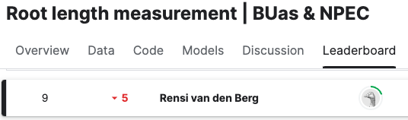
ILO 3
Computer Vision
The student can deliver computer vision solutions to a client.
3/7
3.1
Traditional Computer Vision
Show your best examples using GitHub links, do not go overboard, add in short description, you are free to alter this layout (or add slides per evidence) to suit your needs. Just be sure that it is clear.
MISSING | POOR | INSUFFICIENT | SUFFICIENT | GOOD | EXCELLENT
Not addressed this ILO in your project work. Your project work evidencing can include your Learning Log, Work Log, and supporting documents you submitted on the BrightSpace block assignment. In Section C of your Learning Log, include direct links to required files in your GitHub student repository or OneDrive rather than links to entire folders or the general repository. | The student demonstrates the ability to load, display, and save images, convert between color spaces, and perform basic image manipulations such as resizing, cropping, or rotating, in line with client requirements, using OpenCV or scikit-image. | The student demonstrates the ability to perform intermediate image manipulations such as annotating with shapes, overlaying text, and applying masks to isolate regions, in line with client requirements, using OpenCV or scikit-image. Meets all criteria in Poor. | The student demonstrates the ability to filter images for noise reduction and image enhancement; apply thresholding, edge, and contour detection, in line with client requirements, using OpenCV or scikit-image. Meeting all criteria in Insufficient. | The student demonstrates the ability to execute morphological operations on images; combine various traditional computer vision methods effectively to build image segmentation and object detection pipelines without machine learning, in line with client requirements, using OpenCV or scikit-image. Meeting all criteria in Sufficient. | The student demonstrates the ability to extract, process, and analyze quantitative information from images using appropriate algorithms and methods that are in or outside of the computer vision domain, in line with client requirements. Meeting all criteria in Good.
 | In the notebooks from task 2, 3 and 5, I demonstrated the ability to load display and save images. I also successfully performed basic image manipulations, in line with client requirements. task_2.ipynb task_3.ipynb task_5.ipynb | In the notebooks from task 2, 3 and 5, I demonstrated the ability to perform intermediate image manipulations in line with client requirements. task_2.ipynb task_3.ipynb. task_5.ipynb | In the notebooks from task 2, 3, 5 and 8, I demonstrated the ability to filter images for noise reduction and image enhancement. I successfully applied thresholding, edge and contour detection in line with client requirements. task_2.ipynb task_3.ipynb task_5.ipynb Task 8 | In the notebooks from task 3, 5, 6, 7 and 8 I demonstrated the ability to execute morphological operations in images, and combined various traditional CV methods to build an image segmentation and object detection pipeline in line with client requirements. task_3.ipynb task_5.ipynb task_6.ipynb task_7.ipynb Task 8 | In the notebooks from task 6, 7 and 8 I demonstrated the ability to extract, process and analyze quantitative information from images using appropriate algorithms and methods in line with client requirements. task_6.ipynb task_7.ipynb Task 8

Slide 40
ILO 3
Computer Vision
The student can deliver computer vision solutions to a client.
4/7
3.2
Deep Learning
Show your best examples using GitHub links, do not go overboard, add in short description, you are free to alter this layout (or add slides per evidence) to suit your needs. Just be sure that it is clear.
MISSING | POOR | INSUFFICIENT | SUFFICIENT | GOOD | EXCELLENT
Not addressed this ILO in your project work. Your project work evidencing can include your Learning Log, Work Log, and supporting documents you submitted on the BrightSpace block assignment. In Section C of your Learning Log, include direct links to required files in your GitHub student repository or OneDrive rather than links to entire folders or the general repository. | The student demonstrates the ability to accurately annotate images for object detection or image segmentation, in line with client requirements. | The student demonstrates the ability to plan data collection and evaluate dataset quality with attention to dataset bias, in line with client requirements. Meeting all criteria in Poor. | The student demonstrates the ability to build deep learning models for object detection or image segmentation using frameworks such as TensorFlow or PyTorch, ensuring compatibility between neural network architecture and components and in line with client requirements. Meeting all criteria in Insufficient. | The student demonstrates the ability to design and implement end-to-end computer vision pipelines that merge data processing, traditional computer vision, and deep learning; iterate this pipeline towards an optimal solution using techniques such as transfer learning, hyperparameter tuning, data collections in line with client requirements. Meanwhile, the student tracks these iterations with experiment tracking tools such as Weights & Biases. Meeting all criteria in Sufficient. | The student demonstrates the ability to deliver an optimal computer vision solution, achieving performance that meets or surpasses the client's requirements. Meeting all criteria in Good.
 | I successfully annotated 030_43-2-ROOT1-2023-08-08_pvdCherry_OD001_Col0_05-Fish Eye Corrected.png and 030_43-19-ROOT1-2023-08-08_pvdCherry_OD001_Col0_04-Fish Eye Corrected.png and uploaded them to the Masks dataset. | In the technical report, there is a section 'Dataset' that evaluates the dataset quality with attention to dataset bias. task_2.ipynb | In the notebooks of task 4 and task 8, I demonstrated the ability to build deep learning models for object detection or image segmentation using the right frameworks. I also ensured compatibility between neural netowrk architecture and components in line with client requirements task_4.ipynb Background model Root model Seed model Shoot model Occluded root model Task 8 | In the notebooks from task 7 and 8 I demonstrated the ability to to design and implement end-to-end computer vision pipelines that merge data processing, traditional computer vision, and deep learning; iterate this pipeline towards an optimal solution using techniques such as transfer learning, hyperparameter tuning, data collections in line with client requirements. In this file, I tracked iterations. task_7.ipynb Task 8 | In the notebooks from task 7 and 8, I demonstrated the ability to deliver an optimal computer vision solution, achieving performance that meets the client's requirements. task_7.ipynb Task 8

Slide 41
ILO 4
4
Robotic Control Theory and Reinforcement Learning
The student is able design, implement, and evaluate control algorithms, while implementing object localization and investigating the feasibility of reinforcement learning in order to address the business objective.

Slide 42
ILO 4
Robotics and RL
5/7
4.1
Robotics and Computer Vision
The student is able design, implement, and evaluate control algorithms, while implementing object localization and investigating the feasibility of reinforcement learning in order to address the business objective.
Show your best examples using GitHub links, do not go overboard, add in short description, you are free to alter this layout (or add slides per evidence) to suit your needs. Just be sure that it is clear.
MISSING | POOR | INSUFFICIENT | SUFFICIENT | GOOD | EXCELLENT
 | Identifies relevant environmental input required for situational awareness. Selects and uses appropriate (Python) framework(s) for the chosen control algorithm. Instructions for environment setup, including a list of libraries used are contained in a README.md file on github.com. | The student demonstrates the ability to set up a robotic simulation environment, send commands to a simulated robot, and receive sensor data for processing and situational awareness. And meeting all criteria in poor. | The student demonstrates the ability to create a controller using traditional control theory. The controller must be able to control a robotic manipulator as described in the creative brief. The controller can use co-ordinates as input. A GIF of the working model is presented on github.com. And meeting all criteria in insufficient. | The student demonstrates the ability to integrate a computer vision pipeline into the robotic controller to determine the required co-ordinates according to the requirements in the creative brief. A GIF of the working model is presented on github.com. And meeting all criteria in insufficient. | The student demonstrates the ability to quanitfy the performance of the model according to appropriate performance criteria. The robot controller can respond to different situational conditions using formal logic. The entire code-base is well documented in a README.md file on github.com. And meeting all criteria in good.
 | My README.me file can be found when clicking on the link. It confirms that I Identified relevant environmental input required for situational awareness and selected and used appropriate frameworks for the chosen control algorithm. | In task_9.ipynb I demonstrated the ability to set up a robotic simulation environment, send commands to a simulated robot, and receive sensor data for processing and situational awareness. | In pid1 copy.py, you can find my working controller. The controller can use coordinates as input. You can find a video of my working model here.

Slide 43
ILO 4
The student is able design, implement, and evaluate control algorithms, while implementing object localization and investigating the feasibility of reinforcement learning in order to address the business objective.
Robotics and RL
6/7
4.2
Reinforcement Learning
Show your best examples using GitHub links, do not go overboard, add in short description, you are free to alter this layout (or add slides per evidence) to suit your needs. Just be sure that it is clear.
MISSING | POOR | INSUFFICIENT | SUFFICIENT | GOOD | EXCELLENT
 | Identifies relevant environmental input required for reinforcement learning. Selects approriate (Python) framework(s) for the choosen reinforcement learning algorithm/s. Instructions for environment setup, including a list of libraries used are contained in a README.md file on github.com. | The student demonstrates the ability to create a custom Open AI Gym environment wrapper for the robotic simulation package according to the standard gym framework. The student demonstrates the ability to train a single reinforcement learning model to complete the robotics task described in the creative brief and test it against appropriate performance criteria. The model uses object co-ordinates as input. And meeting all criteria in poor. | The student demonstrates the ability to train and compare the performance of different reinforcement learning models, hyperparameters and reward functions in completing the task successfully. Model hyperparameters are documented in a README.md on github.com. Performance during the training process as well as the end product is documented on github.com. And meeting all criteria in insufficient. | The student demonstrates the ability to complete the task by integrating a computer vision pipeline in the RL controller. All inputs used are realistic and appropriate for the task being addressed. Further, the student demonstrates the ability to use an MLOps tool to track the training process and hyperparameter search. And meeting all criteria in sufficient. | Multiple computer vision reinforcement learning models are trained and tested. Detailed and critical perfomance comparisons are made between reinforcement learning models and traditional control theory. Suggestions for model improvement, real-world implementation, knowledge acquisition and decision-making are made. The entire code-base is well documented in a README.md file on github.com. And meeting all criteria in good.
 | My README.me file can be found when clicking on the link. It confirms that I Identified relevant environmental input required for situational awareness and selected and used appropriate frameworks for the chosen control algorithm. | In ot2_gym_wrapper.py, I demonstrated the ability to create a custom Open AI Gym environment wrapper for the robotic simulation package according to the standard gym framework. In test_wrapper.py I test it. | The best parameters for each student can be found in this README.md file. My training file can be found here. My testing file can be found here.

Slide 44
ILO 5
5
Technical Report: Computer Vision, Reinforcement Learning, and Robotics
The student can translate results into effective reporting.

Slide 45
ILO 5
Technical Report: Computer Vision, Reinforcement Learning, and Robotics
The student can translate results into effective reporting.
7/7
5.1
Technical Report
Show your best examples using GitHub links, do not go overboard, add in short description, you are free to alter this layout (or add slides per evidence) to suit your needs. Just be sure that it is clear.
MISSING | POOR | INSUFFICIENT | SUFFICIENT | GOOD | EXCELLENT
 | The student can write a technical report for the client, with a word count between 3000 and 5000 words. | The student can provide an adequate overview and general explanation on the scope of the work. The student can explain the dataset, its collection and labeling. Meeting all criteria in Poor. | The student includes technical information about their computer vision and robotics pipeline, featuring a flowchart of the pipeline. The student is able to documented all of the sources used with appropriate citation styles. Meeting all criteria in Insufficient. | The student evaluates the performance of their solution by reporting metrics that are in line with client requirement as well as example results of their pipeline. The student can explain and justify the design constraints, alternatives and assumptions. Most of the sentences are well-written and free of grammar, punctuation, and spelling errors. Meeting all criteria in Sufficient. | The student can suggest concrete improvements to their solution. The student can write a report where figures, tables and equations are clearly and logically identified and strongly support the text; all paragraphs are well-organized; use of sections is logical and allows easy navigation through the document. Meeting all criteria in Good.
Please use this link to the report if the other links don't work. | I wrote a technical report with a word count between 3000 and 5000 words. | In the introducton section of the technical report, I provided an adequate overview and general explanation on the scope of the work. In the technical report, under the Dataset section, I explained the dataset, its collection and labeling. | In the technical report, I included technical information about my computer vision and robotics pipeline, featuring a flowchart of both of the pipelines. In the sources section, I documented all of the sources used with appropriate citation style. | For each task, I evaluated the performance of my solution by reporting metrics that are in line with client requirement as well as example results of my pipeline. In the task 8 section in my technical report, I explained and justified the design constraints, alternatives and assumptions. Most of the sentences are well-written and free of grammar, punctuation, and spelling errors. | In task 8 section in my technical report, I suggested a concrete improvement to my solution. In my report, figures, tables and equations are clearly and logically identified and strongly support the text. All paragraphs are well-organized. Use of sections is logical and allows easy navogation through the document.

Slide 46

Medal Challenges
Going the extra mile!

Slide 47
Medal Challenges
Going the extra mile!
1/1
Put your evidence down here to receive a medal!
Show your best examples, do not go overboard, add in short description, you are free to alter this layout (or add slides per evidence) to suit your needs. Just be sure that it is clear.

Slide 48
Section D
D
Reflection
Notes:
MUST BE COMPLETED IN WEEK 8
Summative reflection on your progress during the block including a critical assessment of everything you did and learned during the block. This is a comprehensive review of everything recorded in Section B, evaluated against the goals and planning laid out in Section A.

Slide 49
D
What did I achieve this block?
1/2
My most significant achievements this block
Writing a sucessfull CV pipeline and end 9 on the kaggle leaderboard.
My most difficult challenges this block
Writing a sucessfull CV pipeline and end 9 on the kaggle leaderboard.
The most important lessons I learned
How to write a successfull CV pipeline.

Slide 50
D
How well am I progressing?
2/2
Reflection on my self assessment My self assessment grade is a
8
8
How I plan to improve next block
Work ahead so I don't have much work in the end of the project.

